Slide 1
Recurrent Neural Networks
(RNNs)

Slide 2
Outline
Why Recurrent Neural Networks (RNNs)?
The Vanilla RNN unit
The RNN forward pass
Backpropagation refresher
The RNN backward pass
Issues with the Vanilla RNN

Slide 3
Motivation
• Not all problems can be converted into one with fixed length inputs and outputs
• Problems such as Speech Recognition or Time-series Prediction require a system to store and use context information
– Simple case:
Output YES if the number of 1s is even, else NO 1000010101 – YES, 100011 – NO, …
• Hard/Impossible to choose a fixed context window – There can always be a new sample longer than anything seen

Slide 4
Recurrent Neural Networks (RNNs)
Recurrent Neural Networks take the previous output or hidden states as inputs. The composite input at time t has some historical information about the happenings at time T < t
• RNNs are useful as their intermediate values (state) can store information about past inputs for a time that is not fixed a priori

Slide 5
Predicting Time Series Data
Day | Temperature
Day 1 | 25°C
Day 2 | 40°C
Day 3 (Today) | 12°C
Day 4 (Tomorrow) | ?

Slide 6
Predicting Time Series Data
Day | Temperature | Normalized Temperatures
Day 1 | 25°C | 0.5
Day 2 | 40°C | 1
Day 3 (Today) | 12°C | 0
Day 4 (Tomorrow) | ? | ?

Slide 7
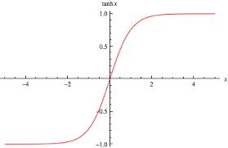
Predicted Value
Input
w₁
b₁
w₃
b₂
× 0.8
+ 0.0
× 1.2
+ 0.0

Slide 8
Predicted Value
Input
w₁
b₁
w₃
b₂
0.5
× 0.8
+ 0.0
× 1.2
+ 0.0
0.456
Yesterday’s temperature
Today’s temperature
1.2×0.38+0.0=0.456
tanh(0.8×0.5 + 0.0) tanh(0.4)=0.38

Slide 9
Predicted Value
Input
w₁
b₁
w₃
b₂
0.5
× 0.8
+ 0.0
× 1.2
+ 0.0
Yesterday’s temperature
Today’s temperature

Slide 10
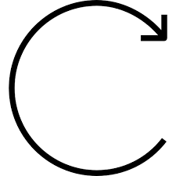
Predicted Value
Input
w₁
b₁
w₃
b₂
× 0.8
+ 0.0
× 1.2
+ 0.0
Today’s temperature
× 0.3
w₂

Slide 11
(Input for Today × w₁) + (y₁ × w₂)
Predicted Value
Input
w₁
b₁
w₃
b₂
× 0.8
+ 0.0
× 1.2
+ 0.0
Today’s temperature
× 0.3
w₂

Slide 12

Day before Yesterday
Predicted Value for Yesterday
w₁
b₁
w₃
b₂
× 0.8
+ 0.0
× 1.2
+ 0.0
× 0.3
w₂
Predicted Value for Today
Yesterday
w₁
b₁
w₃
b₂
× 0.8
+ 0.0
× 1.2
+ 0.0
× 0.3
w₂
Predicted Value for Tomorrow
Today
w₁
b₁
w₃
b₂
× 0.8
+ 0.0
× 1.2
+ 0.0

Slide 13
Day before Yesterday
Predicted Value for Yesterday
w₁
b₁
w₃
b₂
0.5
× 0.8
+ 0.0
× 1.2
+ 0.0
0.772
× 0.3
w₂
tanh(0.8×1+0.3×0.38+0.0)
Predicted Value for Today
Yesterday
w₁
b₁
w₃
b₂
1
× 0.8
+ 0.0
× 1.2
+ 0.0
× 0.3
w₂
Predicted Value for Tomorrow
Today
w₁
b₁
w₃
b₂
0
× 0.8
+ 0.0
× 1.2
+ 0.0

Slide 14
Day before Yesterday
Predicted Value for Yesterday
w₁
b₁
w₃
b₂
0.5
× 0.8
+ 0.0
× 1.2
+ 0.0
0.772
× 0.3
w₂
tanh(0.8×1+0.3×0.56+0.0)
Predicted Value for Today
Yesterday
w₁
b₁
w₃
b₂
1
× 0.8
+ 0.0
× 1.2
+ 0.0
0.92
× 0.3
w₂
tanh(0.8×0+0.3×0.767+0.0)
Predicted Value for Tomorrow
Today
w₁
b₁
w₃
b₂
0
× 0.8
+ 0.0
× 1.2
+ 0.0
0.272

Slide 15
Day before Yesterday
Predicted Value for Yesterday
w₁
b₁
w₃
b₂
0.5
× 0.8
+ 0.0
× 1.2
+ 0.0
0.772
× 0.3
w₂
tanh(0.8×1+0.3×0.56+0.0)
Predicted Value for Today
Yesterday
w₁
b₁
w₃
b₂
1
× 0.8
+ 0.0
× 1.2
+ 0.0
0.92
× 0.3
w₂
tanh(0.8×0+0.3×0.767+0.0)
Predicted Value for Tomorrow
Today
w₁
b₁
w₃
b₂
0
× 0.8
+ 0.0
× 1.2
+ 0.0
0.272
1.2×0.226 + 0.0 = 0.272

Slide 16
Recurrent Neural Networks (RNNs)
Note that the weights are shared over time
• Essentially, copies of the RNN cell are made over time (unrolling/unfolding), with different inputs at different time steps

Slide 17
Day before Yesterday
Predicted Value for Yesterday
w₁
b₁
w₃
b₂
0.5
× 0.8
+ 0.0
× 1.2
+ 0.0
0.772
× 0.3
w₂
tanh(0.8×1+0.3×0.56+0.0)
Predicted Value for Today
Yesterday
w₁
b₁
w₃
b₂
1
× 0.8
+ 0.0
× 1.2
+ 0.0
0.92
× 0.3
w₂
tanh(0.8×0+0.3×0.767+0.0)
Predicted Value for Tomorrow
Today
w₁
b₁
w₃
b₂
0
× 0.8
+ 0.0
× 1.2
+ 0.0
0.272
1.2×0.226 + 0.0 = 0.272

Slide 18
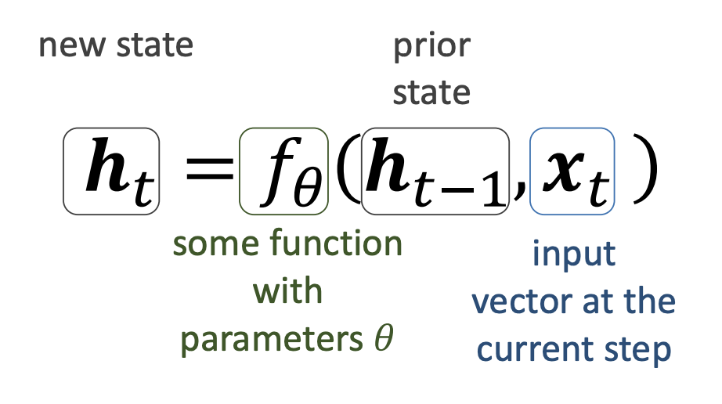
Recurrent Neural Network
We can process a sequence of vectors 𝒙_{𝑡} by applying a recurrence formula at every time step

Slide 19
The same function 𝑓_{𝜃} and the same set of parameters 𝜃 are used at every time step

Slide 20
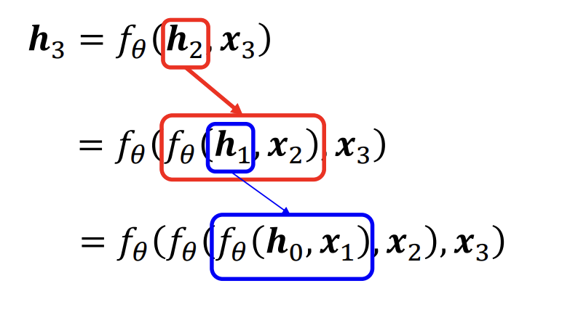

Slide 21
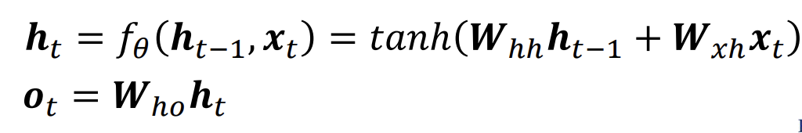

Slide 22



Day before Yesterday
Predicted Value for Yesterday
w₁
b₁
w₃
b₂
w₂
Predicted Value for Today
Yesterday
w₁
b₁
w₃
b₂
w₂
Predicted Value for Tomorrow
Today
w₁
b₁
w₃
b₂

Slide 23
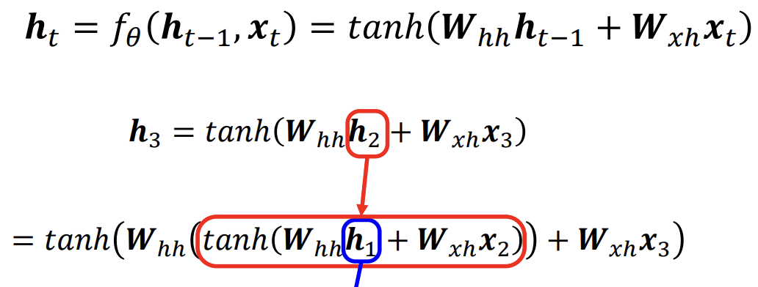

Slide 26
Day before Yesterday
Predicted Value for Yesterday
w₁
b₁
w₃
b₂
w₂
Predicted Value for Today
Yesterday
w₁
b₁
w₃
b₂
w₂
Predicted Value for Tomorrow
Today
w₁
b₁
w₃
b₂

Slide 27
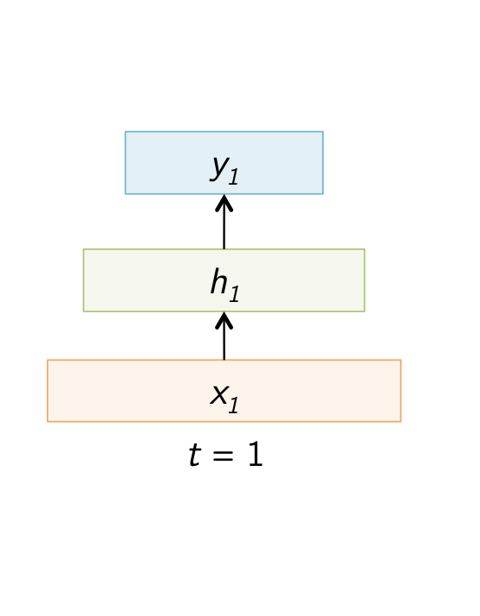
Sample Feed Forward Network

Slide 28
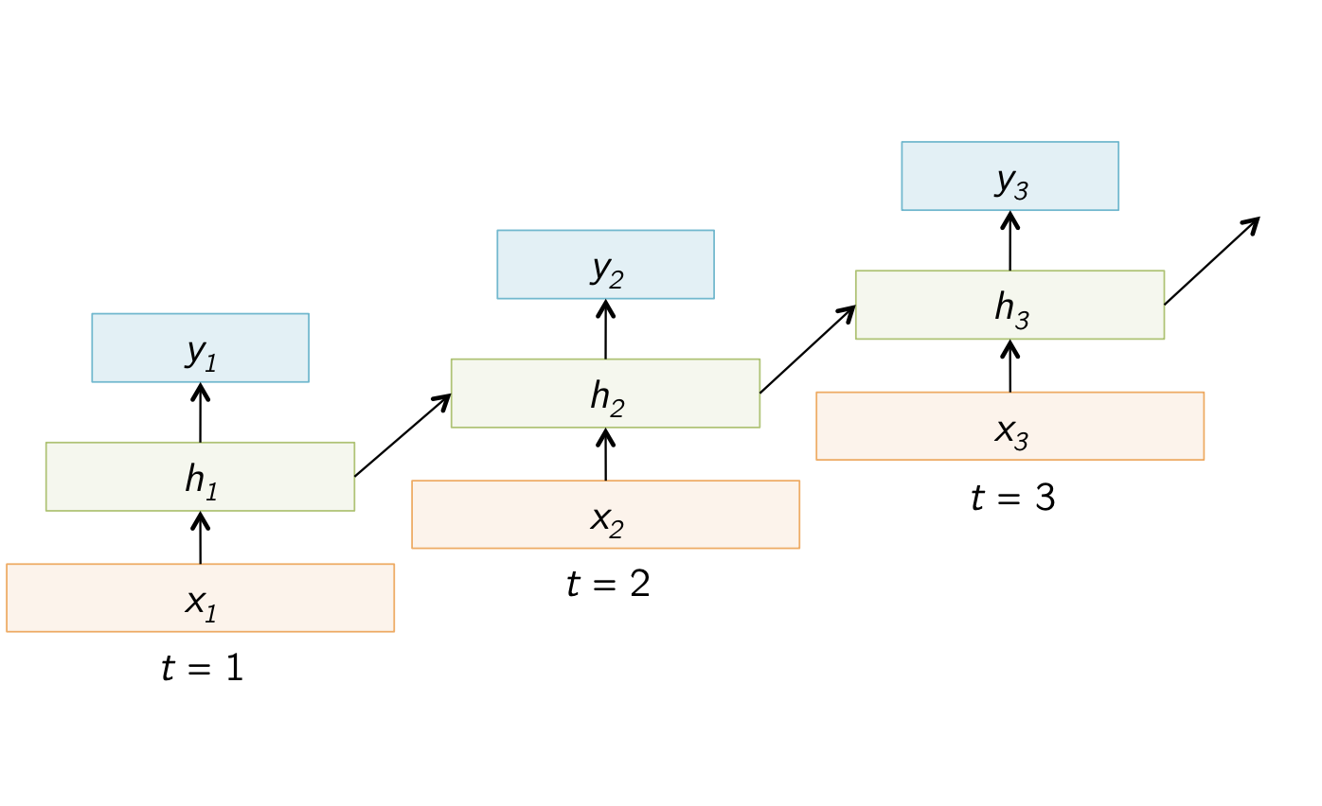
Sample Recurrent Neural Network

Slide 29
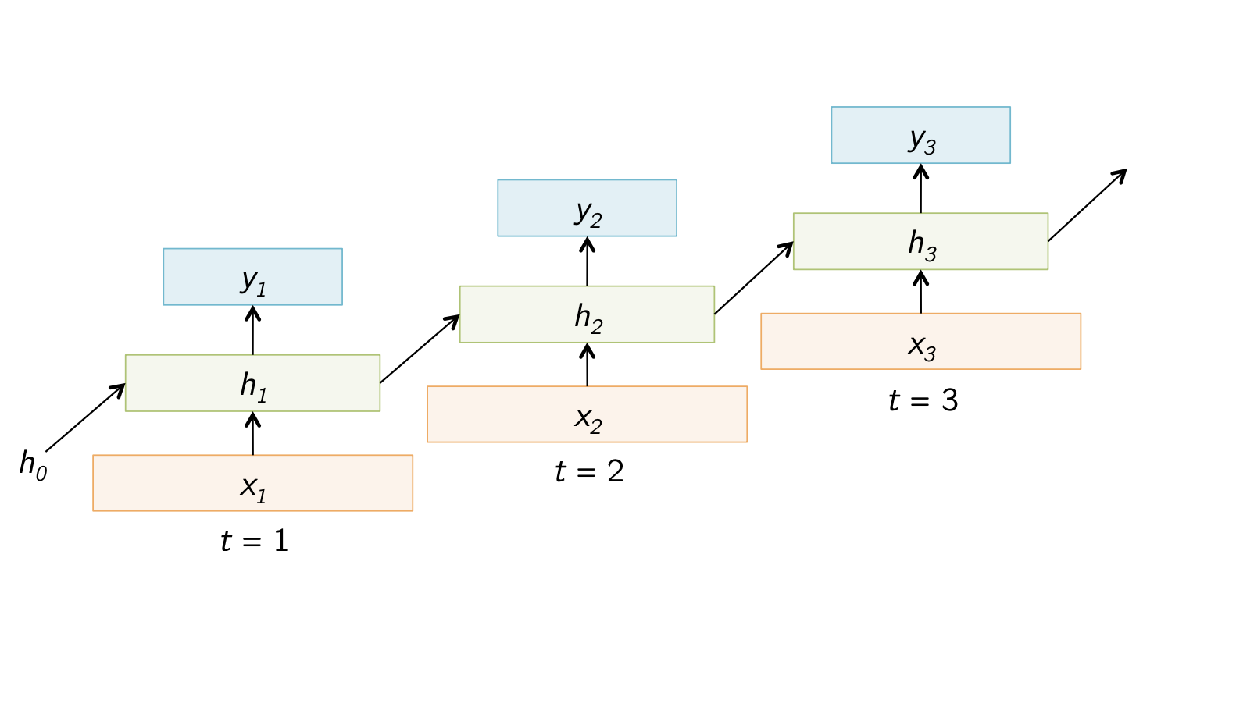
Sample Recurrent Neural Network

Slide 30
Sample Recurrent Neural Network

Slide 31
Sentiment Classification
Classify a restaurant review from Zomato OR movie review from IMDB OR … as positive or negative
• Inputs: Multiple words, one or more sentences
• Outputs: Positive / Negative classification
• “The food was really good”

Slide 32
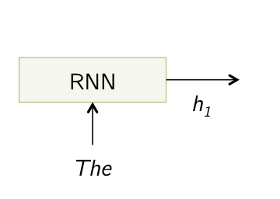
Sentiment Classification

Slide 33
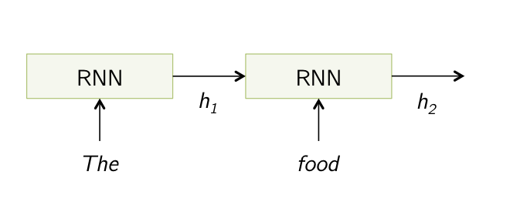
Sentiment Classification

Slide 34
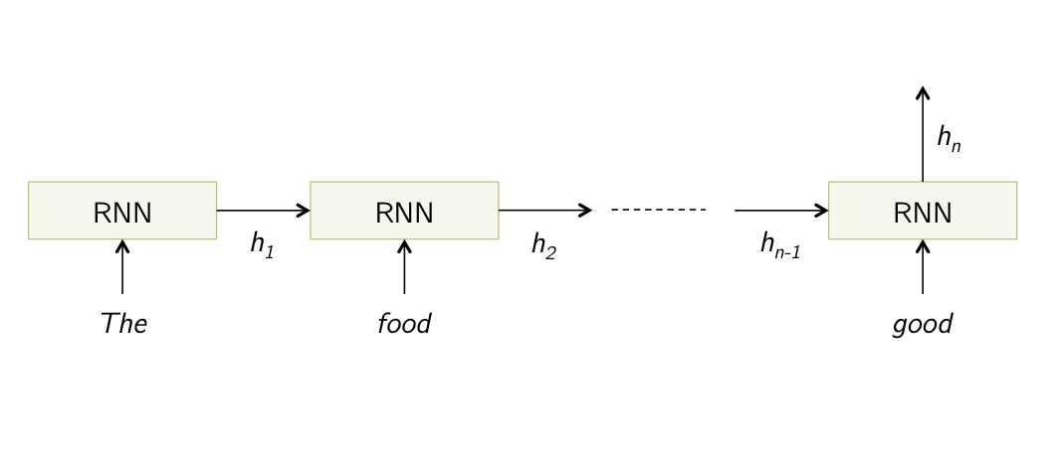
Sentiment Classification

Slide 35
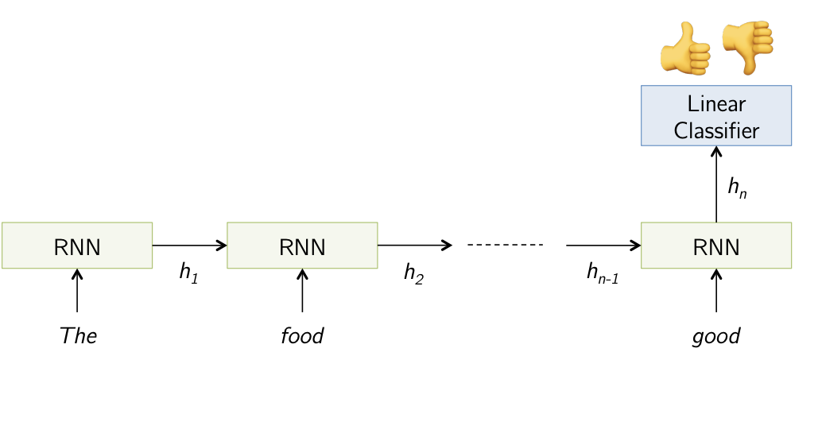
Sentiment Classification

Slide 36
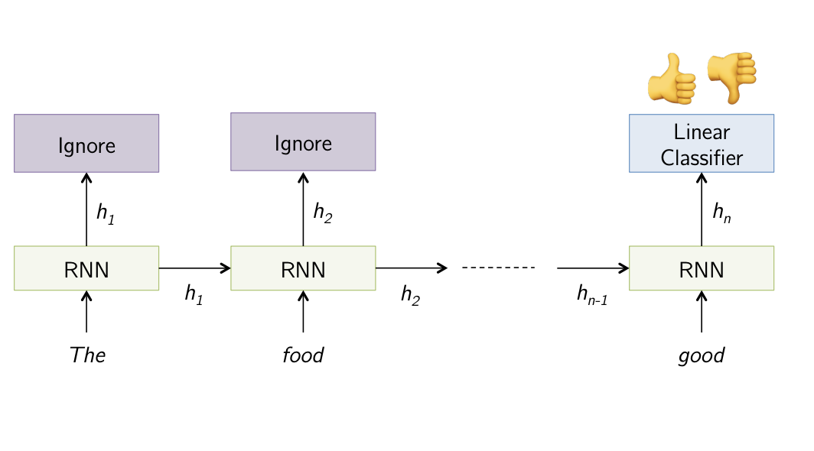
Sentiment Classification

Slide 37
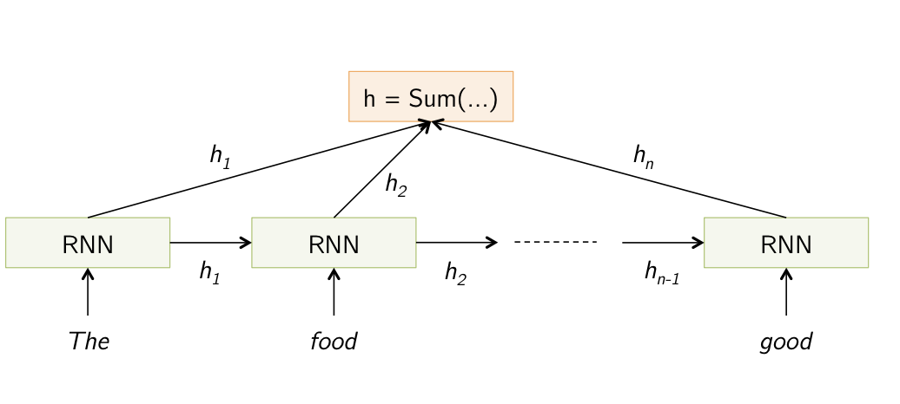
Sentiment Classification

Slide 38
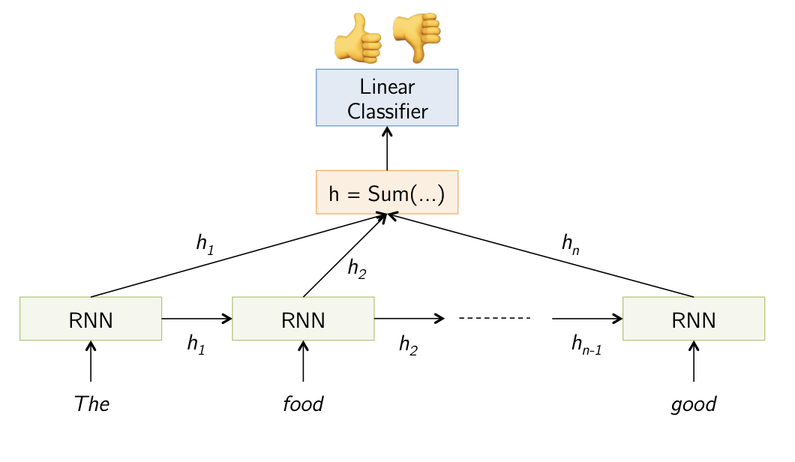
Sentiment Classification

Slide 39
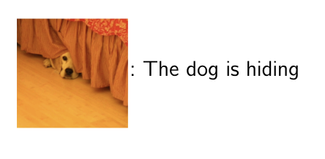
Image Captioning
Given an image, produce a sentence describing its contents
• Inputs: Image feature (from a CNN)
• Outputs: Multiple words (let’s consider one sentence)

Slide 40
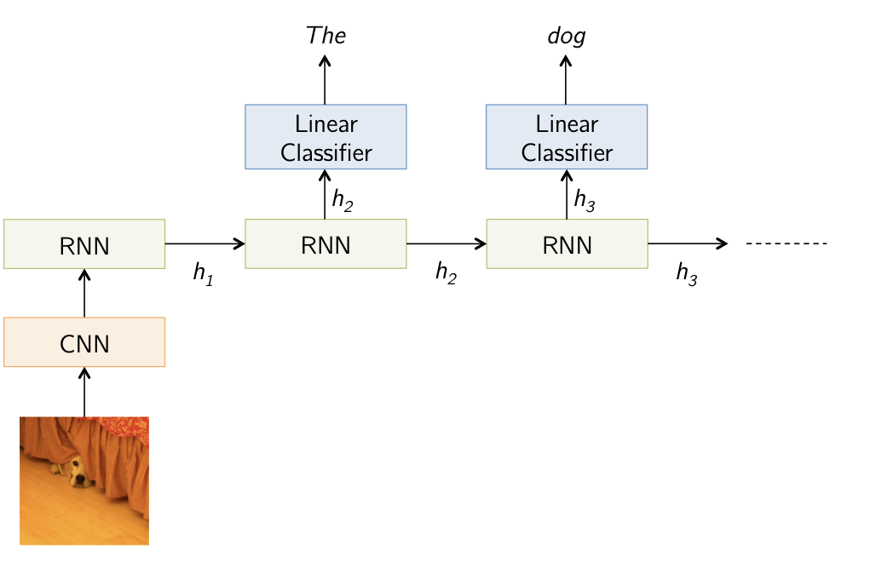
Image Captioning

Slide 41
Treat the unfolded network as one big feed-forward network!
• This big network takes in entire sequence as an input
• Compute gradients through the usual backpropagation
• Update shared weights
y₀
y₁
y₂
x₀
x₁
x₂

Slide 42
How do the Weights get updated through time?

Slide 43


Backpropagation - Gradient Descent Revisited
x₁ | x₂ | y
1 | 2 | 3
2 | 3 | 5
3 | 4 | 7
4 | 5 | 9
5 | 6 | 11

Slide 44
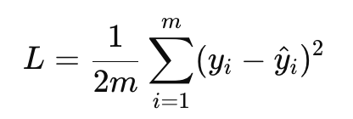
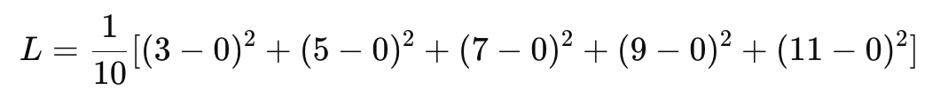
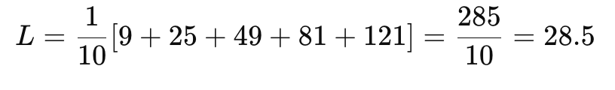
Backpropagation - Gradient Descent Revisited
x₁ | x₂ | y | ŷ
1 | 2 | 3 | 0
2 | 3 | 5 | 0
3 | 4 | 7 | 0
4 | 5 | 9 | 0
5 | 6 | 11 | 0

Slide 45
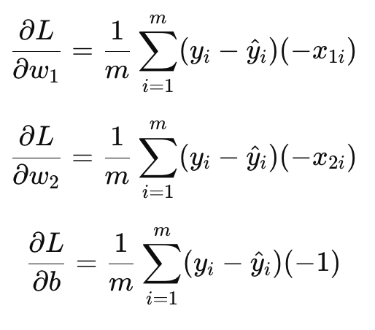
Backpropagation - Gradient Descent Revisited
x₁ | x₂ | y | ŷ
1 | 2 | 3 | 0
2 | 3 | 5 | 0
3 | 4 | 7 | 0
4 | 5 | 9 | 0
5 | 6 | 11 | 0

Slide 46
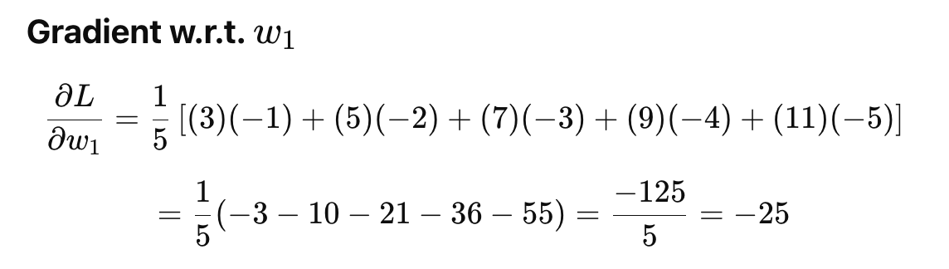

Slide 47
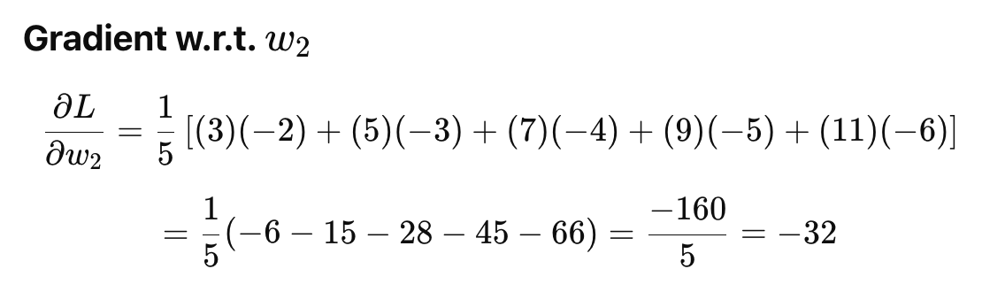

Slide 48
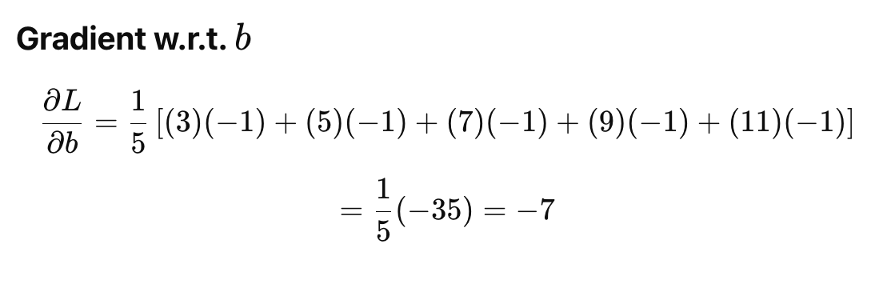

Slide 49
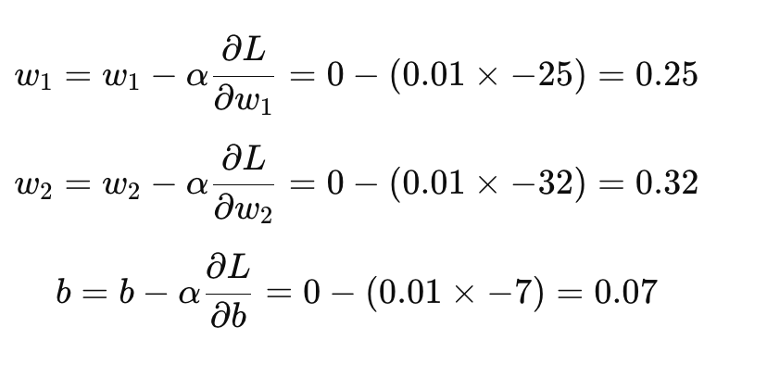
Updation of Parameters

Slide 50

Updation of Parameters

Slide 51
Stochastic Gradient Descent (SGD)

Slide 52

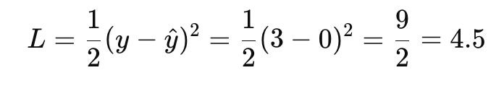
Stochastic Gradient Descent

Slide 53
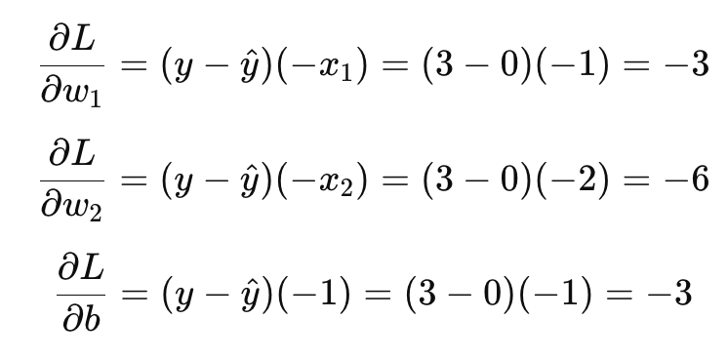

Slide 54
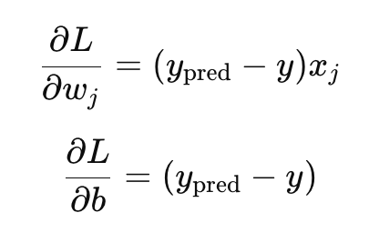
Stochastic Gradient Descent

Slide 55
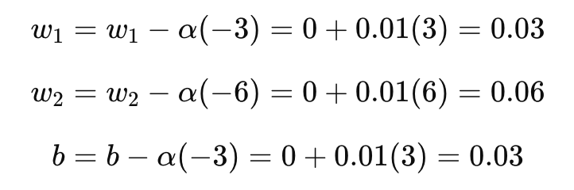
Updation of Parameters - SGD

